Slide 1
Lab3 CUDA Basic
Nov, 2023 Parallel Programming

Slide 2
Overview
Platform guide
Tools
Assignment

Slide 3
Platform Guide

Slide 4
The GPU Cluster
Host: hades.cs.nthu.edu.tw
Account: same as apollo
Password: same as apollo

Slide 5




The GPU Cluster
GPU Server with GTX1080 x 2
Frontend Server without GPU cards
(hades01)
Client
(Your computer)
ssh
hades02
slurm
hades03-07
ssh hades.cs.nthu.edu.tw

Slide 6
The GPU Cluster
ssh
hades01
CPU
Node
hades02
1080*2
hades03
1080*2
hades04
1080*2
hades05
1080*2
hades06
1080*2
hades07
1080*2
slurm

Slide 7
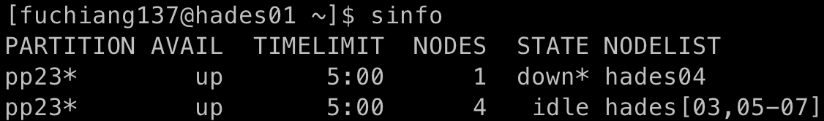
Job Scheduler
SLURM
Course partition: pp23
Limitation
2 gpus
5 minutes

Slide 8
Instructions to compile a CUDA program
Compile
nvcc [options] <inputfile>
e.g., nvcc cuda_code.cu -o cuda_executable
If you have a Makefile, simply
make

Slide 9
Instructions to run a CUDA program
hades02
ssh hades02
If you want to specify which GPU to use.
export CUDA_VISIBLE_DEVICES=<gpu id>
eg. export CUDA_VISIBLE_DEVICES=1
eg. export CUDA_VISIBLE_DEVICES=0,1
hades[03-07]
Slurm
Access gpus with flag --gres=gpu:<number of gpu>
eg. srun -n 1 --gres=gpu:1 ./executable
eg. srun -n 1 --gres=gpu:2 ./executable
If Two GPUs are requested, they will be on the same node.

Slide 10
Platform Guide (NCHC CT)

Slide 11
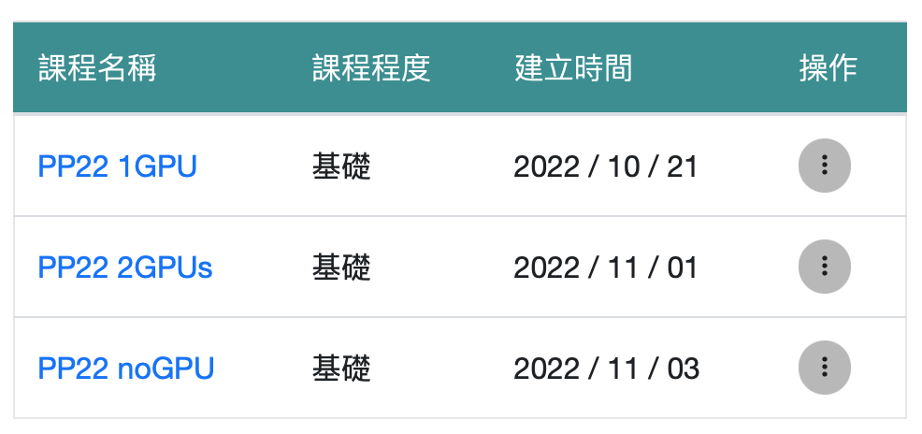
NCHC Container
round
B*B blocks
……
round/2
B*B blocks
Webpage: https://portal.apps.edu-cloud.nchc.org.tw
Tutorial: https://hackmd.io/@enmingw32/pp-nchc
Register your account first
GPU: RTX 3070
Total available GPUs: 36
Please stop your container if you aren’t using it
……
round/2
B*B blocks

Slide 12


Register
1
Your gmail account
Enter whatever you want
2

Slide 13
Login

Slide 14
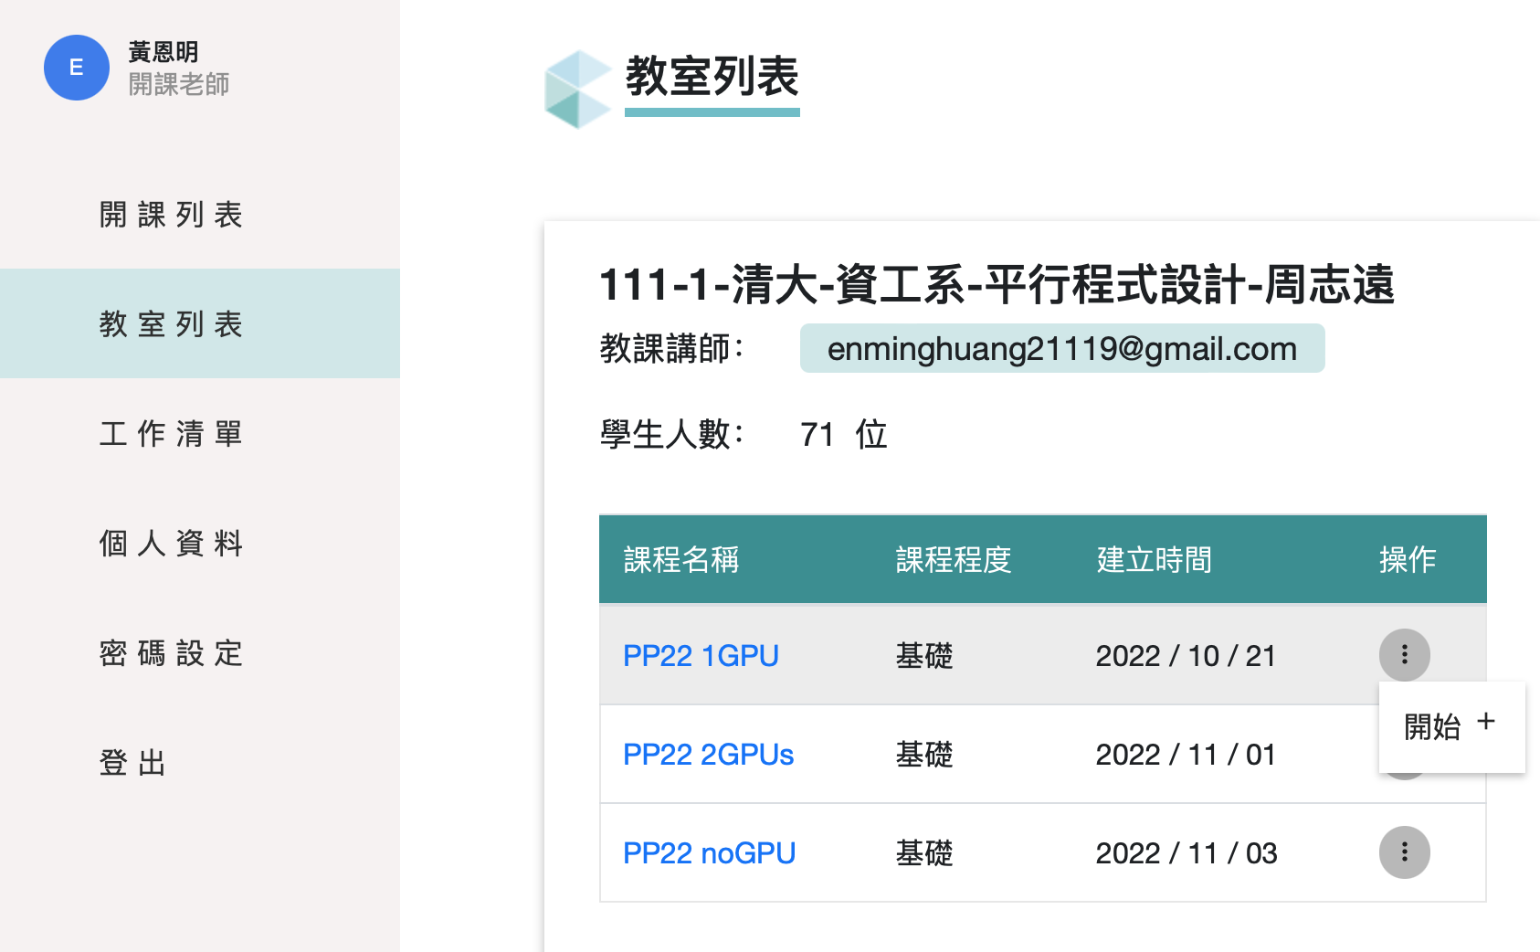
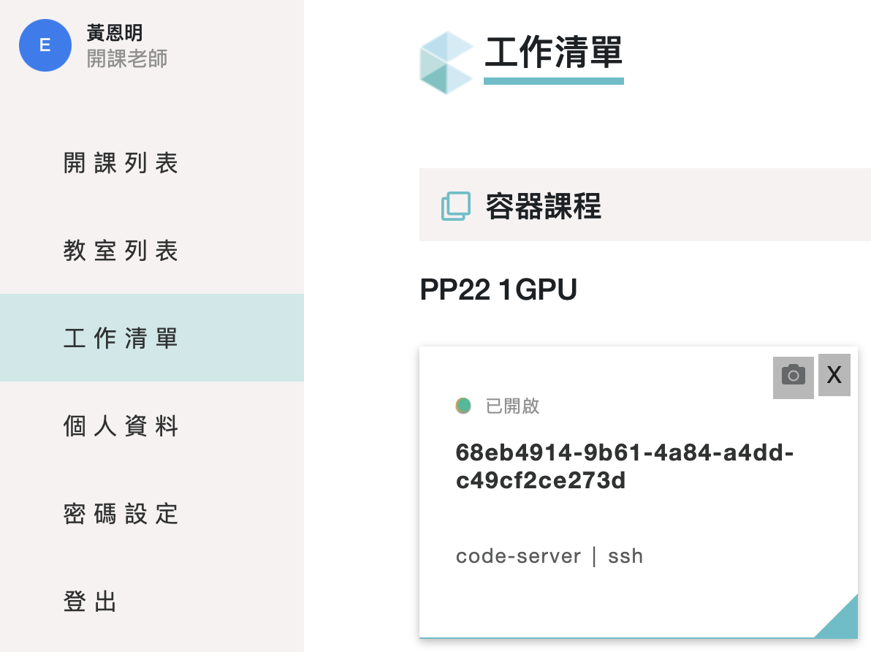
Start Container
1
3
2

Slide 15
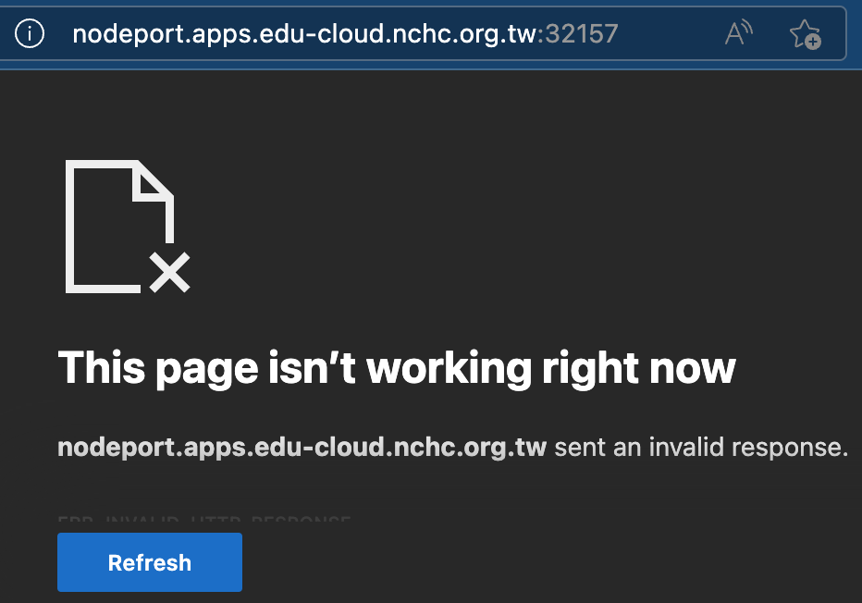
Access the Container
SSH
The port number will be different
Codeserver (the web version of vscode)
Click the “code-server” button
MobaXterm or Terminal:
ssh root@nodeport.apps.edu-cloud.nchc.org.tw -p 32157

Slide 16
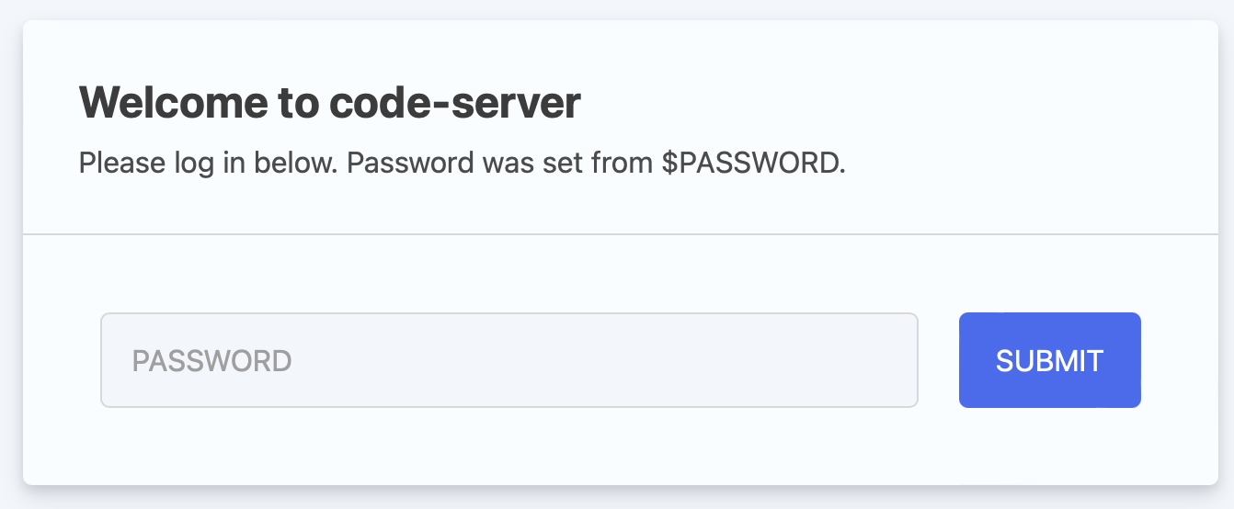
User & Password
User: root
Password: student
The password of ssh and code-server is the same

Slide 17
First-time Setup Script
Open terminal in the container:
bash <(curl -s https://apollo.cs.nthu.edu.tw/pp23/setup-remote.sh)
The script will execute the following commands:
Set proper bash config for homework and lab judger (e.g., hw3-2-judge)
Generate ssh key and install it on Apollo (you will be prompted to enter your Apollo account name and password)
Run this script only once, even you relaunched your container (since your personal data will be kept).

Slide 18
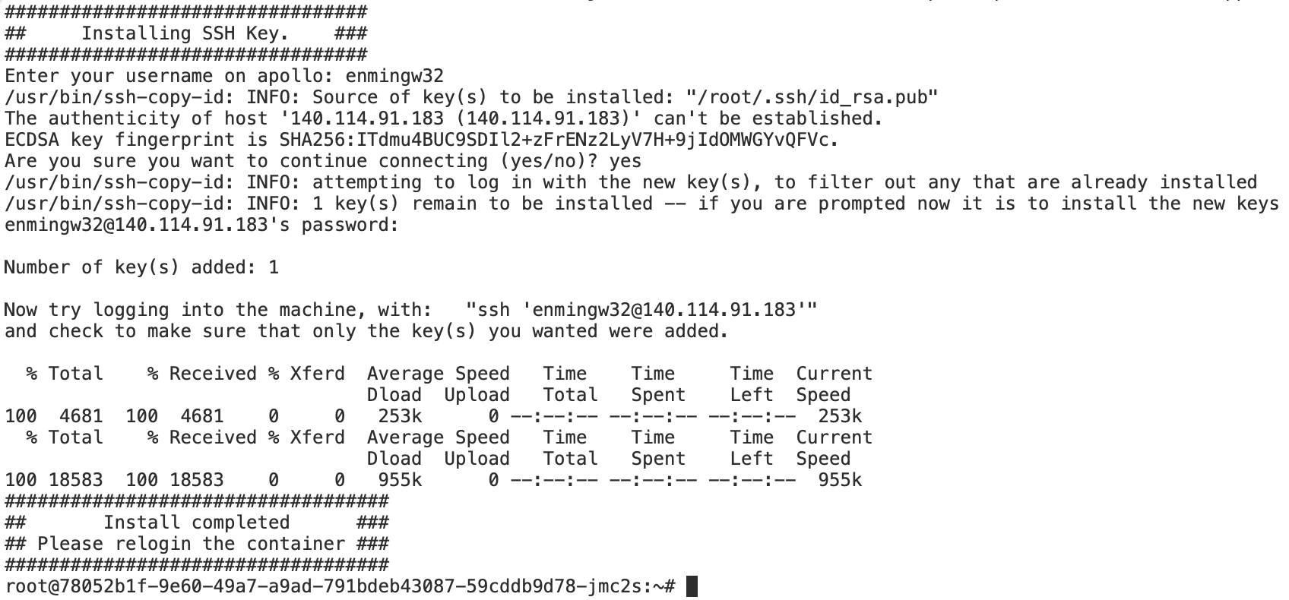

Slide 19
Stop your container
Please stop your container if you aren’t using it; otherwise, other students may not have enough GPU resources
Your files located under $HOME (/root/) will be preserved

Slide 20
NO MINING
Educational use only
Please cherish the computing resources we provided

Slide 21
Practice
In this practice, try to run the deviceQuery
Steps:
cp -r /home/pp23/share/lab1/deviceQuery $HOME
cp -r /tmp/dataset-nthu-pp23/pp23/share/lab3/deviceQuery $HOME
cd $HOME/deviceQuery
nvcc deviceQuery.cpp -o deviceQuery
Run it with
hades02 or NCHC container
SLURM scheduler
How many CUDA cores on this machine?
Hades
NCHC

Slide 22
Tools

Slide 23
nvidia-smi
NVIDIA System Management Interface program
You can query details about
gpu type
gpu utilization
memory usage
temperature
clock rate
...

Slide 24
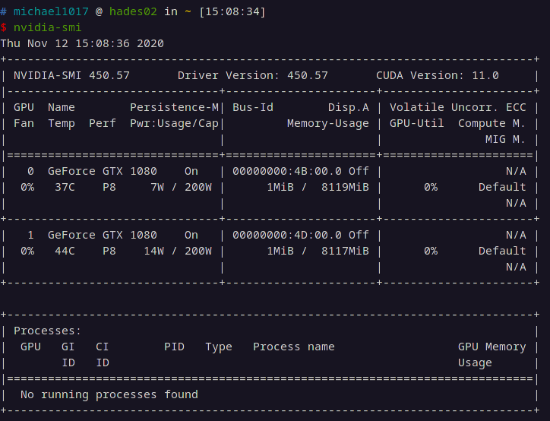
nvidia-smi example

Slide 25
cuda-memcheck
This tool checks memory errors of your program, and it also reports hardware exceptions encountered by the GPU. These errors may not cause program to crash, but they could result in unexpected program behavior and memory misusage.
Error types
cuda-memcheck

Slide 26
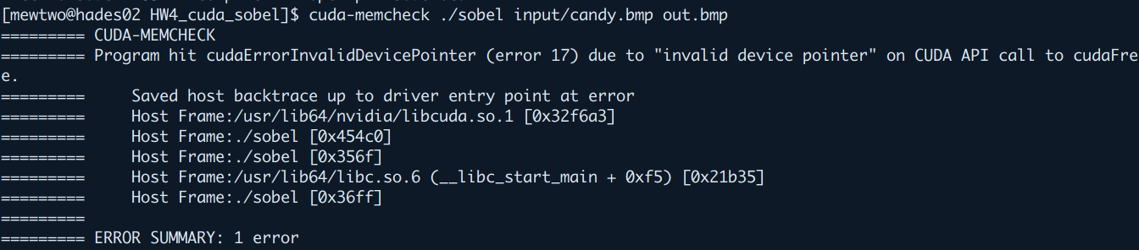
cuda-memcheck

Slide 27
cuda-gdb
cuda-gdb tutorial

Slide 28
nvprof & nsight-compute
They are CUDA profilers provide you feedback about how to optimize CUDA programs
nvprof ./lab3 in.png out.png
-o <FILE> to save result to a file
-i <FILE> to read result from a file
hades: nvprof
NCHC: nsight-compute (command: ncu)

Slide 29
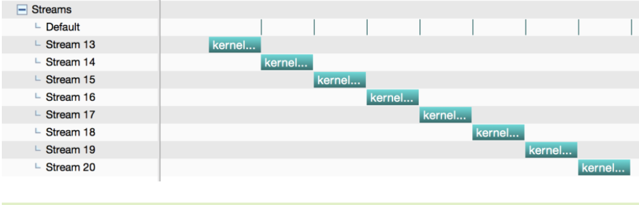
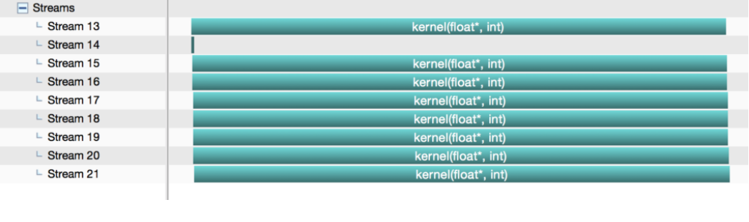
nvvp
nvvp-tutorial
GUI version of nvprof
Useful for the stream optimization
Timeline
nvvp is useful for checking the concurrency of stream

Slide 30
Lab3 Assignment

Slide 31

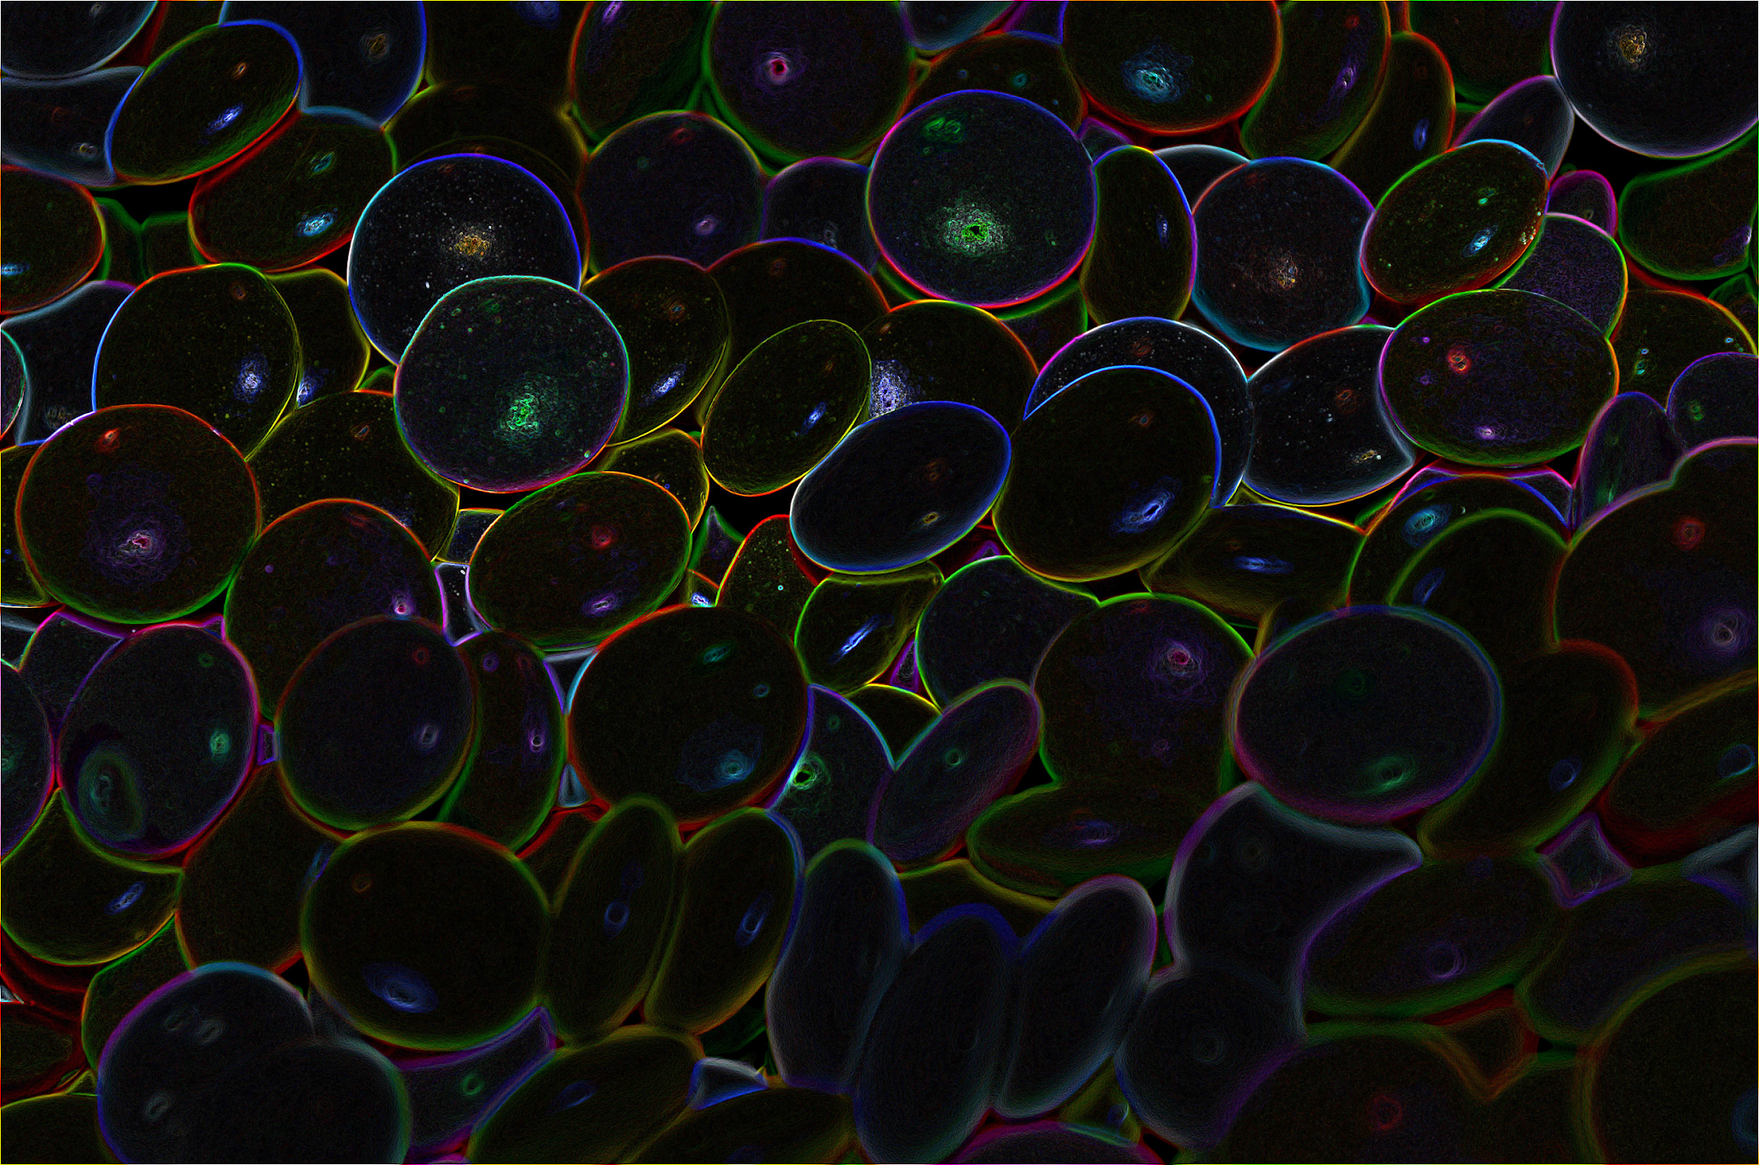
Problem Description
Edge Detection: Identifying points in a digital image at which the image brightness changes sharply

Slide 32
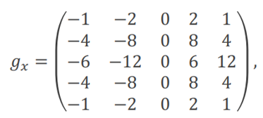
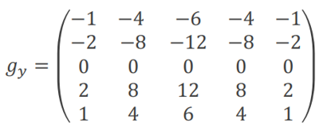
Sobel Operator
Used in image processing and computer vision, particularly within edge detection algorithms.
Uses two 3x3 filter matrix gx, gy which are convolved with the original image to calculate approximations of the derivatives - one for horizontal changes, and one for vertical.
In this lab, we use 5x5 kernels

Slide 33
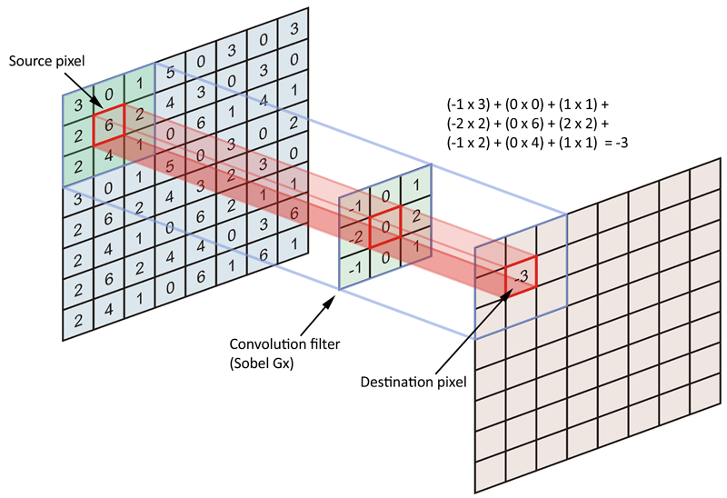
Convolution Calculation
Iterate through the width and height of the image
For each pixel, multiply the filter matrix with original image element-wisely and sum them up.
Credit: https://soubhihadri.medium.com/image-processing-best-practices-c-part-2-c0988b2d3e0c

Slide 34
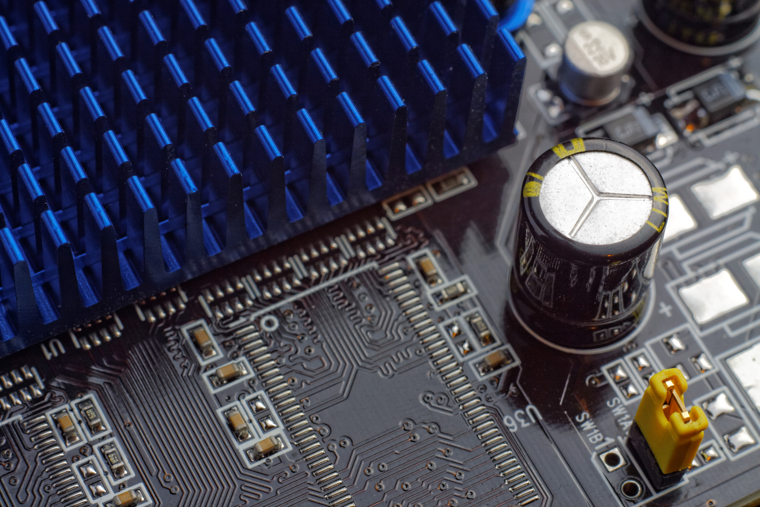
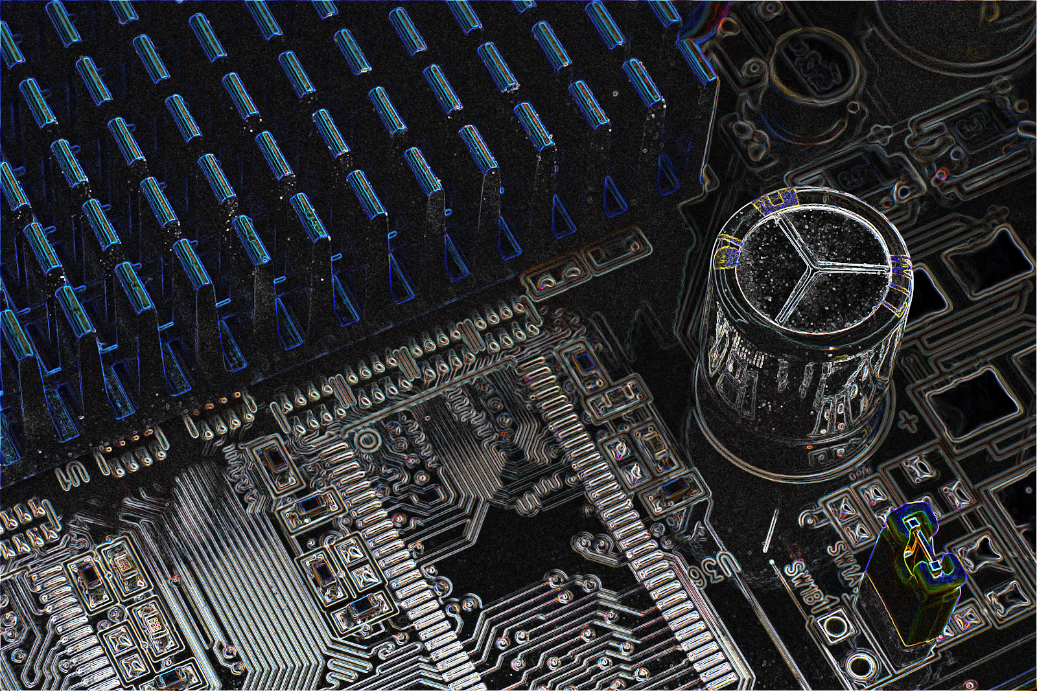
Sample Result

Slide 35
Preparation
TA provided CPU version, Makefile, and hint
Files are located at /home/pp23/share/lab3
Please do not copy the testcases
lab3.cu is cpu version(you need to rewrite it with cuda!)
Follow hints if you have no idea about how to rewrite

Slide 36
How to run
hades02
./lab3 <input> <output>
CUDA_VISIBLE_DEVICES=0 ./lab3 <input> <output>
hades[03-07]
srun -n 1 --gres=gpu:1 ./lab3 <input> <output>

Slide 37
Check the correctness
png-diff <result_file> <answer_file>
It verifies the correctness of your output result
result_file is the output file from your CUDA program.
answer_file is the provided file for correctness checking.
If your input_file is “/home/pp23/share/lab3/testcases/candy.png” , your answer_file is “/home/pp23/share/lab3/testcases/candy.out.png”
Your code is correct if you see “ok, 100.00%”

Slide 38
Hints
Malloc memory on GPU
Copy the original image to GPU
Put filter matrix on device memory (or declare it on device)
Copy filter matrix to shared memory (don’t let only one thread do it)
Parallelize the sobel computing
Copy the results from device to host
Free unused address

Slide 39
Submission
Judge will execute your code with single process, single GPU
Submit your code and Makefile (optional) to eeclass before 11/16 23:59
Use lab3-judge
Get started as soon as possible to avoid heavy queueing delay
Try to write your code on NCHC, and perform fine tune on Hades

